Slide 1

Cloud Computing Fundamentals
Understanding the backbone of modern technology

Slide 2

What is Cloud Computing?
On-Demand Access
Scalable Resources
Computing resources available instantly over the internet
Storage, processing power, and applications that grow with your needs
Pay-As-You-Use
Only pay for what you consume, no upfront hardware costs

Slide 3
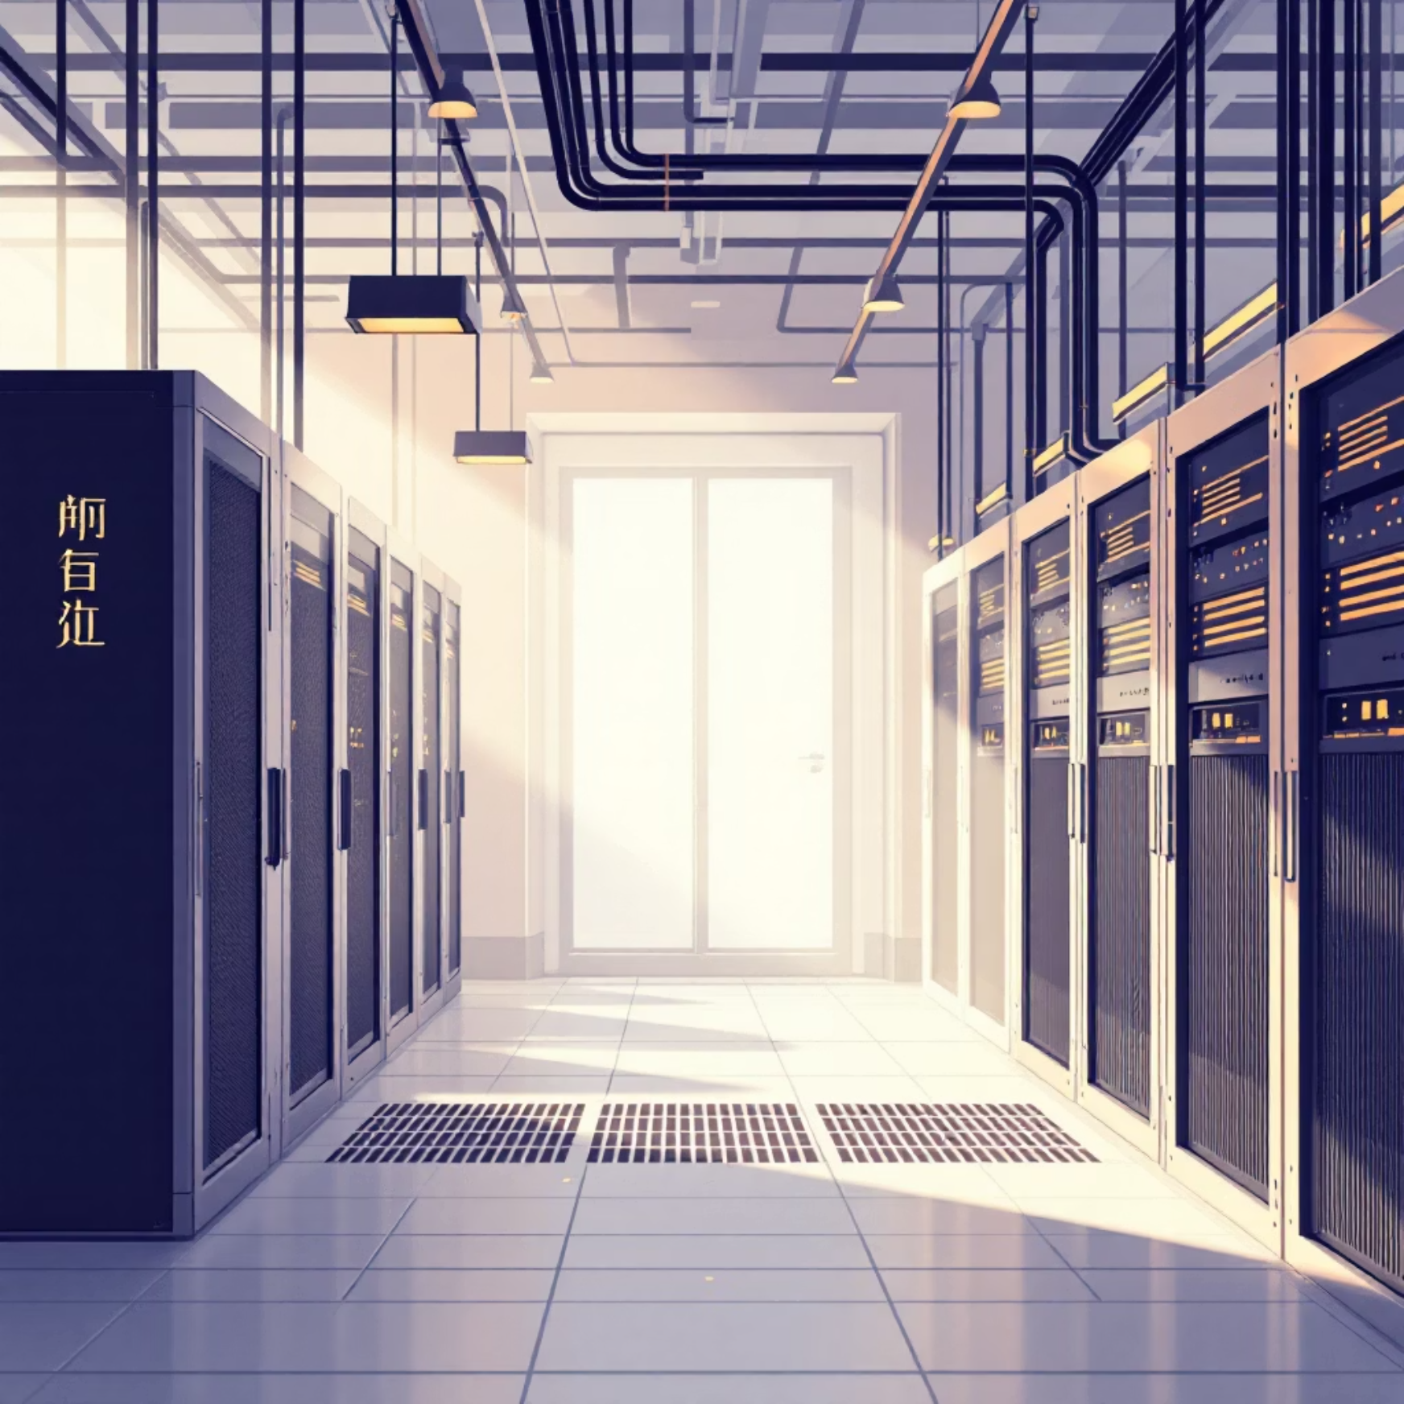

Traditional vs Cloud Servers
Traditional Servers
Cloud Servers
Physical hardware on-premises
Virtual resources in the cloud
High upfront costs
Flexible pricing models
Limited scalability
Instant scaling up or down
Manual maintenance required
Managed by cloud provider

Slide 4
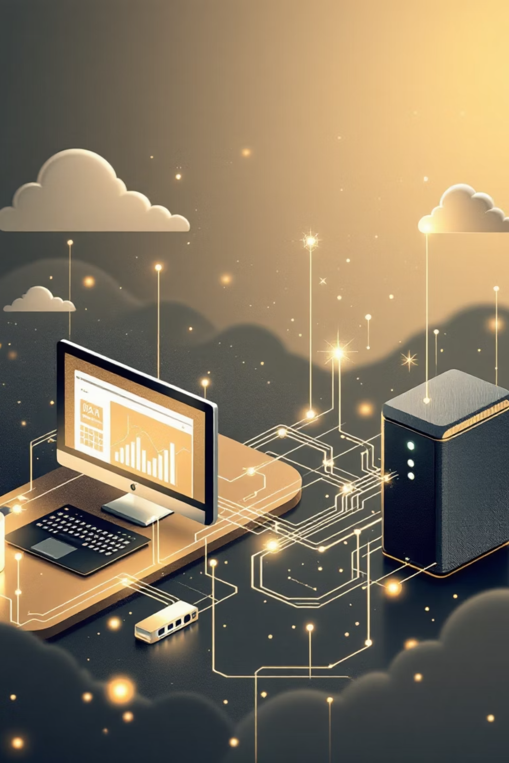




How Websites Work
User Request
Browser sends request for website
DNS Lookup
Domain name converted to IP address
Server Response
Web server sends back website files
Page Display
Browser renders the website

Slide 5

What is an IP Address?
Digital Address
Unique numerical identifier for every device on the internet
Example: 192.168.1.1
Two Main Types
IPv4: 32-bit addresses (most common)
IPv6: 128-bit addresses (newer standard)

Slide 6

Understanding Domains
01
02
03
Human-Readable Names
Domain Structure
DNS Translation
Easy-to-remember website addresses like google.com
Subdomain + Domain Name + Top-Level Domain (.com, .org)
Converts domain names to IP addresses automatically

Slide 7




Web Hosting Explained
Storage Space
Server space where your website files live
Internet Access
Makes your website accessible worldwide 24/7
Security & Maintenance
Provider handles server security and updates

Slide 8



Types of Web Hosting
Shared Hosting
Multiple websites share one server
Most affordable option
VPS Hosting
Virtual private server with dedicated resources
Better performance & control
Dedicated Hosting
Entire server dedicated to your website
Maximum performance & security

Slide 9
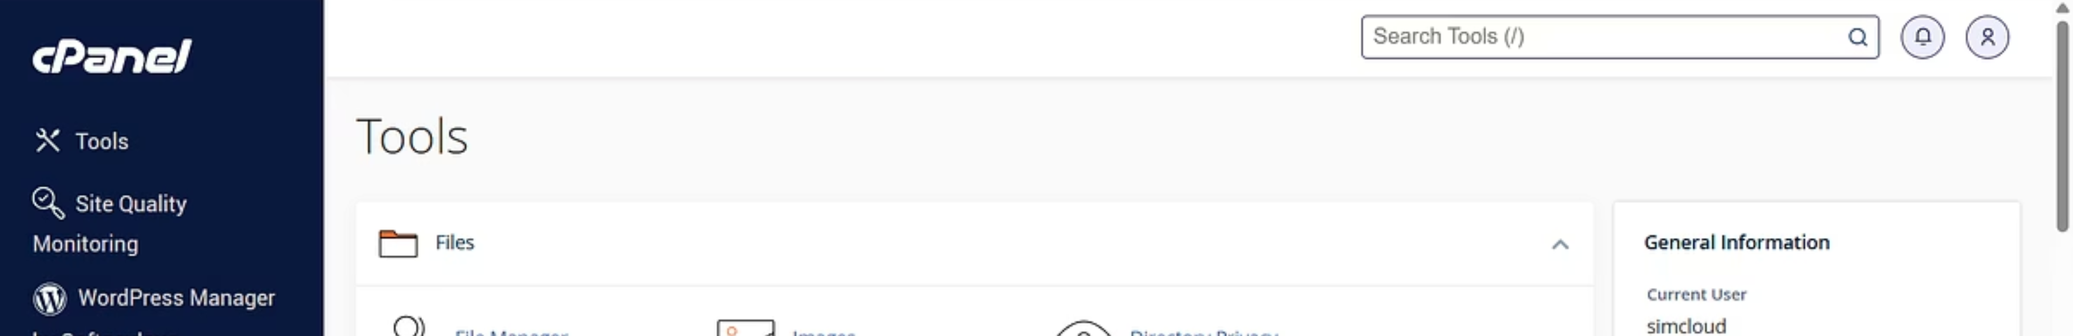




What is cPanel?
Control Panel
File Management
Web-based interface for managing your hosting account
Upload, organize, and edit website files easily
Email Setup
Database Control
Create and manage email accounts for your domain
Manage MySQL databases and backups

Slide 10

The Cloud Revolution
1
Traditional Era
Physical servers, high costs, limited flexibility
2
Cloud Transition
Virtual resources, scalable solutions, global access
3
Modern Web
Instant deployment, automatic scaling, worldwide reach
Welcome to the future of computing

